Slide 1
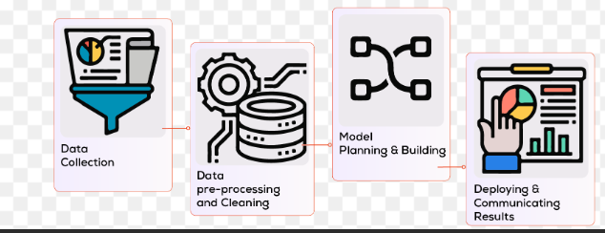
The Data Science Process

Slide 2
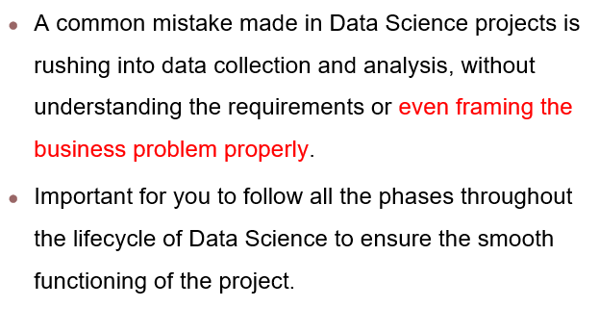
A common mistake in Data Science Projects
Notes:
‹#›

Slide 3
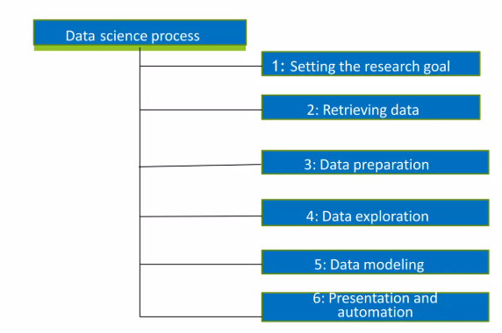
Data Science Process

Slide 4
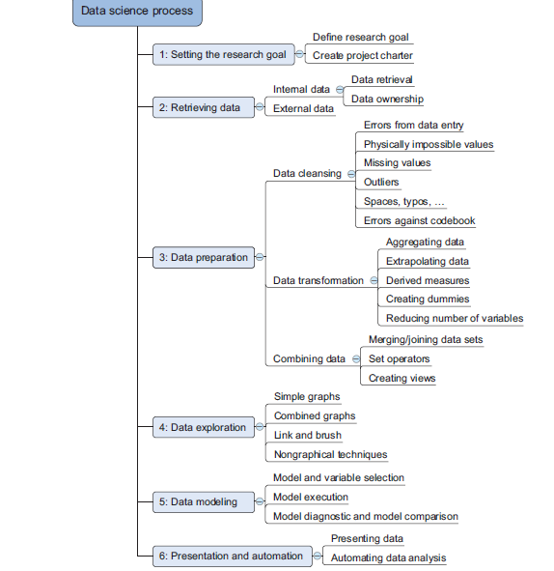

Slide 5
1. Setting the Research Goal
A project starts by the WHAT, the Why and the HOW?
WHAT is the problem?
This defines what you want to solve or predict. e.g : A university wants to know why student enrollment is decreasing over the last 3 years.
WHY is it important?
This explains the purpose and value of solving the problem.
e.g :Understanding the reason for declining enrollment helps the university improve marketing strategies, revise programs, and increase admissions.
HOW will it be solved?
This identifies how data science techniques will be used to achieve the goal.
e.g: Analyze historical enrollment data, student feedback surveys, and marketing data using statistical analysis and machine learning models.
Notes:
Understanding buiseness goals and context is essential
‹#›

Slide 6
1. Setting the Research Goal
Outcome of first phase:
Research goal
Understanding of the context
Project plan with well-defined milestones
List of deliverables
Involves Senior personnel
Notes:
Understanding buiseness goals and context is essential
‹#›

Slide 7
1. Setting the Research Goal
Research goal
Understanding business goals and context is essential
Data scientists often fail to understand business goals
Take this phase seriously
Spend more time
Involve people with domain expertise
Example:
“Identify key factors affecting student enrollment and predict enrollment trends for the next two years.”

Slide 8
1. Setting the Research Goal
Understanding of the Context:
Knowledge of the business, academic, or real-world domain.
Example: Understanding admission policies, fee structure, program demand, and competition from other universities.
Project Plan with Well-Defined Milestones
A roadmap of tasks and timelines.
Example Milestones:
Data collection – Week 1
Data cleaning – Week 2
Data analysis – Week 3
Model development – Week 4
Final report – Week 5

Slide 9
1. Setting the Research Goal
List of Deliverables
Clear outputs that will be produced.
Example Deliverables:
Cleaned dataset
Analytical report
Predictive model
Visualization dashboard
Involvement of Senior Personnel
Senior stakeholders ensure the project is aligned with organizational goals.
Example: University dean and admission director validate the research goal and approve the final outcomes.

Slide 10
1. Setting the Research Goal
Project Charter :
A project charter is a foundational document that formally defines and approves a project by outlining its goals, approach, resources, timeline, and deliverables.
It is created during Step 1: Setting the Research Goal.
Example:
Project: Predict Student Performance Charter Defines:
Goal: Identify the reason and how to improve
Method: Statistical analysis + ML
Deliverables: Model, report, dashboard
Timeline: 5 weeks

Slide 11
2. Retrieving Data
Retrieving data is getting data from any source in a form that you can load into your analysis environment for cleaning, transformation, and modeling. This involves further three steps :
Start with data available internally
Getting data from other sources
Quality check

Slide 12
Start with Data Available Internally
Most organizations already collect and store data as part of their routine operations. This internal data is usually the first and most reliable source for analysis.
Examples of Internal Data Sources:
Databases: Customer records stored in SQL databases
Data warehouses: Historical sales and transaction data
Flat files: CSV or text files generated by systems
Workbooks: Excel sheets maintained by departments
Hard copies: Printed reports, forms, and registers
Example: A university may have student data stored in:
Admission database
Excel files for attendance
Printed result sheets
Access Considerations: Access to internal data often depends on:
Company policies
Data privacy rules
Organizational hierarchy and politics
For example, financial data may only be accessible to senior management.

Slide 13
Getting Data from External Sources
When internal data is insufficient, organizations rely on external data sources.
Common External Data Sources
Online data portals (e.g., government open data websites)
Data published by companies
Research labs and academic institutions
Public APIs and reports
Example: A weather prediction project may use:
Internal sensor data
External meteorological data published by research organizations
External data is often well-documented and high quality because it is published for public or research use.

Slide 14
Quality Check of Collected Data
After collecting data (internal or external), a quality check must be performed before analysis.
Why Quality Checks are Important
Errors are easier to detect at an early stage
Prevents incorrect conclusions later
Common Quality Checks
Ensure data is of the correct data type
Example: Age should be numeric, not text
Ensure data is in the correct format
Example: Date should be in YYYY-MM-DD format
Check for missing values, impossible values, and inconsistencies
Example: If a salary column contains values like "50k" instead of 50000, it must be corrected.

Slide 15
3. Data Preparation
Data cleaning
Data Integration
Data Transformation
Data Reduction
Notes:
Data preparation is the process of cleaning and transforming raw data prior to processing and analysis.
A codebook describes the layout of the data in the data file and describes what the data codes mean. Codebooks are used to document the values associated with the answer options for a given survey question.
‹#›

Slide 16
3. Data Preparation
Data Cleaning
Data cleaning is the process of fixing or removing incorrect, corrupted, or incomplete data within a dataset.
Errors from data entry
Impossible values
Missing values
Outliers
Spaces, typos…etc
Notes:
Data preparation is the process of cleaning and transforming raw data prior to processing and analysis.
A codebook describes the layout of the data in the data file and describes what the data codes mean. Codebooks are used to document the values associated with the answer options for a given survey question.
‹#›

Slide 17


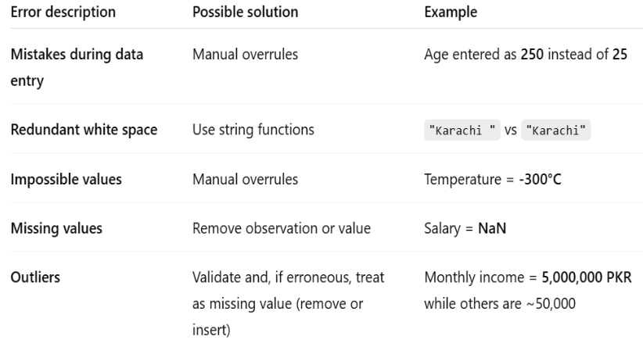
3. Data Preparation

Slide 18
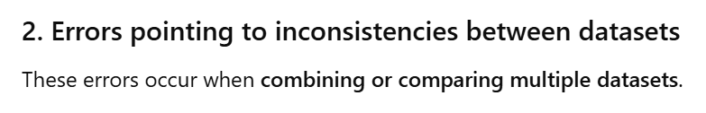
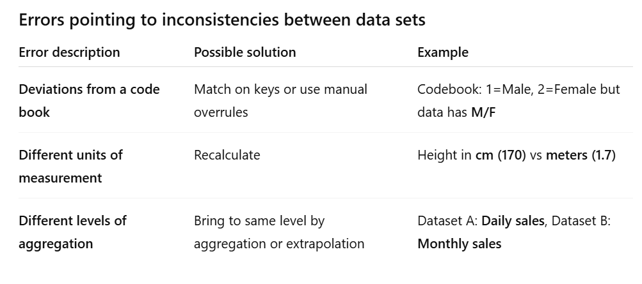


Slide 19
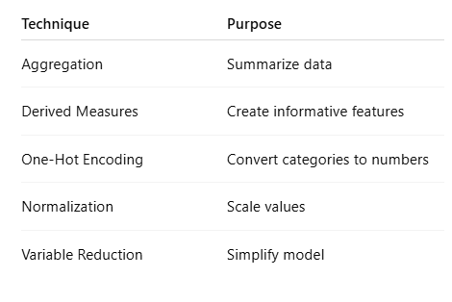
3. Data Preparation
Data transformation
Data transformation is the process of converting raw data into a structured, unified format to enhance its usability, compatibility, and quality.
Notes:
Extrapolation is the process of taking data values at points x₁, ..., x_{n}, and approximating a value outside the range of the given points.
A dummy variable is one that takes only the value 0 or 1 to indicate the absence or presence of some categorical effect that may be expected to shift the outcome.
‹#›

Slide 20
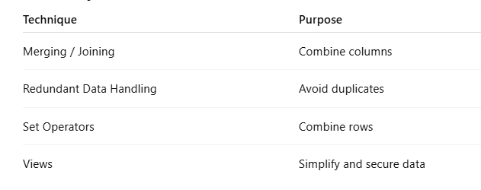

3. Data Preparation
Data Integration :
It is the process of combining data from multiple sources into a single, consistent dataset for analysis or decision-making.
Merging / joining data sets
Address redundant data
Set operators
Creating views

Slide 21
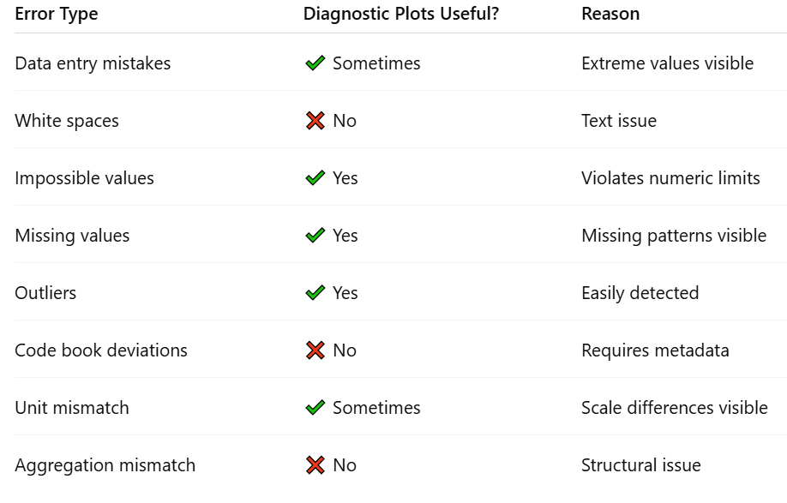
Diagnostic Plots

Slide 22
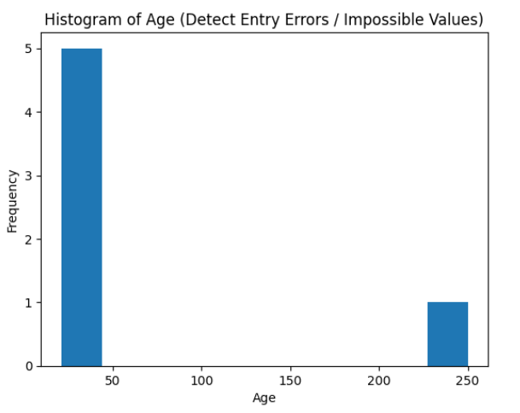
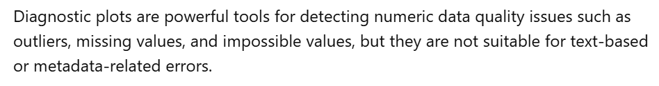

Slide 23
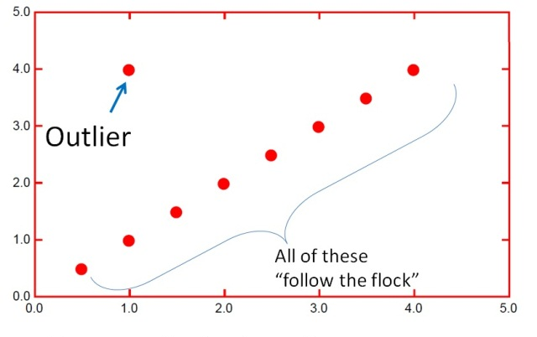
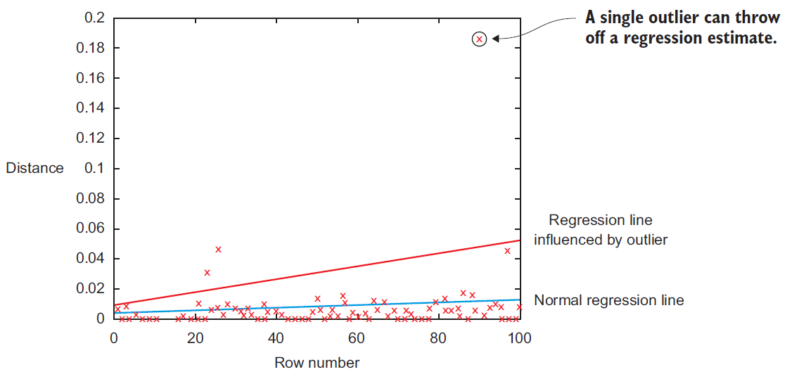

Slide 24
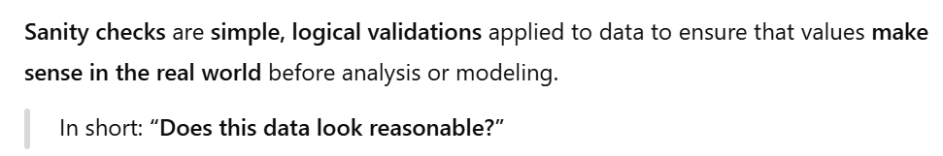
3. Data Preparation – Cleansing Data (removing errors in data)
Sanity checks
Check for incorrect values
Check for out of range values
Check for data type mismatch
Often these checks can be easily enforced in Programs

Slide 25
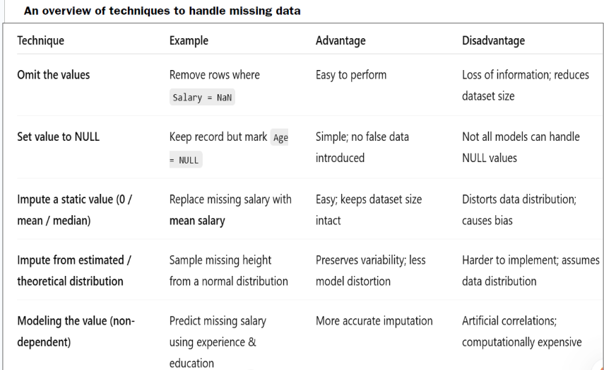
3. Data Preparation – Cleansing Data (removing errors in data)

Slide 26
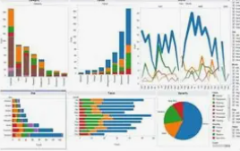

4. Exploratory Data Analysis
EDA is a critical step in data science where we analyze and understand the data before applying models. The main goal is to discover patterns, spot anomalies, test hypotheses, and check assumptions.
Graphical Techniques
Computing Descriptive Analysis
Detecting Errors During EDA
Notes:
Tabulating is a way of processing information or data by putting it in a table. This doesn't mean the kind of table you eat off of, though.
‹#›

Slide 27
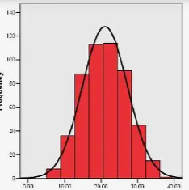
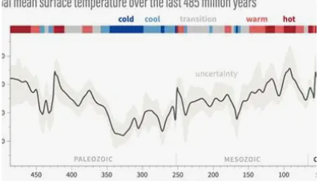
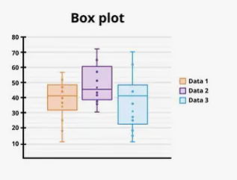
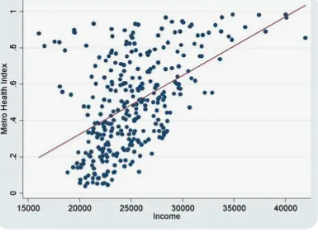
Graphical Techniques
EDA usually uses visualizations because humans understand patterns faster visually. Some common types are:
Histogram
Shows the distribution of a single variable.
Helps detect skewness, outliers, and gaps.
Example: distribution of students’ scores.
Line Chart
Shows trends over time.
Example: daily temperature over a month.
Box Plot (or Whisker Plot)
Shows spread of the data, median, quartiles, and outliers.
Example: salaries in a company to see if there are unusually high or low values.
Scatter Plot
Shows relationship between two variables.
Example: hours studied vs exam score.

Slide 28
2. Computing Descriptive Analysis
EDA is not just visual. You can also use:
Tabulation / Summary Statistics
Mean, median, standard deviation, counts of categories, missing values.
Example: average salary by department.
Clustering
Grouping similar data points to find patterns. Example: grouping customers by spending habits.
Simple Model Building
Trying a simple model can reveal relationships, missing patterns, or errors. Example: linear regression to check how one variable predicts another.

Slide 29
3. Detecting Errors During EDA
EDA helps catch errors that are often hidden, such as:
Impossible values (e.g., negative age, temperature = 1000°C)
Missing values or inconsistencies
Outliers (e.g., extremely high or low data points that don’t make sense)
Duplicate entries or mislabels
These errors, if undetected, can mislead your models later.

Slide 30
5. Build the Models
The goal of modeling is to create mathematical or computational models that can predict outcomes, classify data, or discover patterns in the dataset.
Prediction → Forecast future values (e.g., predict stock prices or temperature).
Classification → Assign items to categories (e.g., email → spam or not spam).
Clustering → Group similar data points without predefined labels (e.g., customer segmentation).

Slide 31
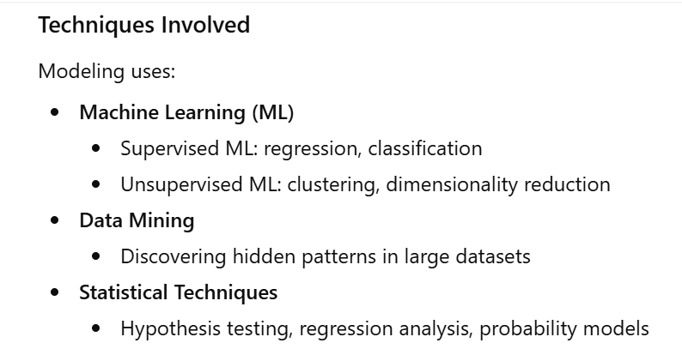

Slide 32
Three Main Steps in Modeling
Model and Variable Selection
Choose a model depending on your task:
Regression → predicting numerical values
Classification → predicting categories
Clustering → grouping similar items
Select variables (features) that are most important for prediction.
Example:
For predicting house prices, select features like area, bedrooms, location, not irrelevant ones like paint color.

Slide 33

2. Model Execution (Training)
Train the selected model using historical data.
The model learns relationships between input variables and output.
This step may include:
Splitting data into training and testing sets
Parameter tuning
Example:
Training a linear regression model to learn how study hours affect exam scores.

Slide 34
3. Model Diagnostics and Comparison
Evaluate how well the model performs using metrics:
Prediction → RMSE, MAE
Classification → Accuracy, Precision, Recall
Clustering → Silhouette Score, Davies-Bouldin Index
Compare different models to choose the best one.
Example:
Compare Linear Regression vs Random Forest for predicting house prices.

Slide 35
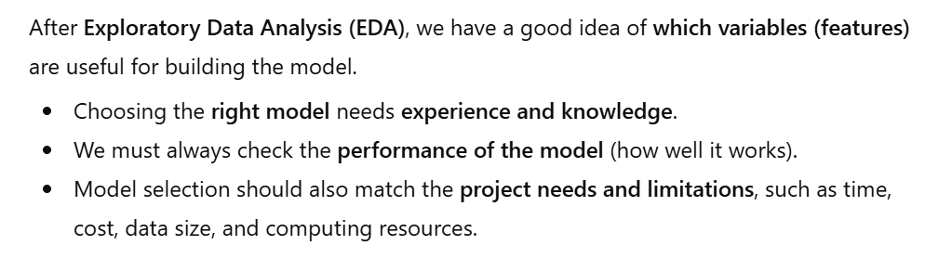
5. Build the Models – Model and Variable Selection

Slide 36
Other Factors to Consider
In real life, a model is not judged only by how accurate it is. We also need to think about practical issues.
1. Using the Model in Real Systems
Will the model be used in a real system?
Can it be easily added to a website, mobile app, or software system?
Some models are accurate but very hard to use in real applications.
2. Maintaining the Model
How often does the model need updates?
Will it still work well after some time?
Can it adjust when data changes over time (for example, customer behavior changes)?

Slide 37
Other Factors to Consider
3. Easy to Understand
Does the model need to be easy to explain to people like managers or clients?
Simple models are often preferred because they are easy to understand and explain.
Example
A bank may choose a model that is easy to explain for loan approval, even if it is slightly less accurate, rather than a complex model that no one understands.

Slide 38
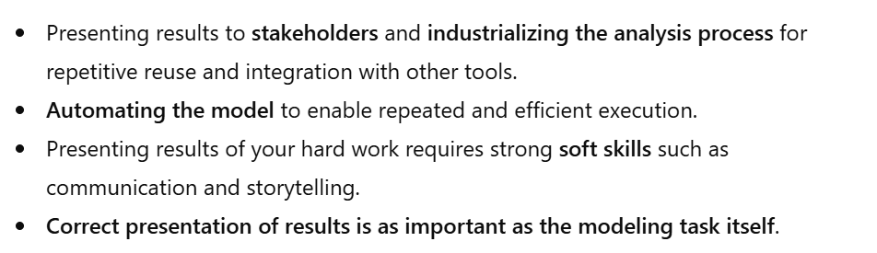
6. Presentation and Automation

